Slide 1

Data Driven Education
Discussion Forum Subteam
Presentation 2 - 3/16/2022
Notes:
Pratik

Slide 2
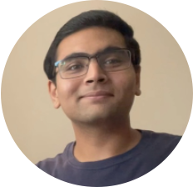

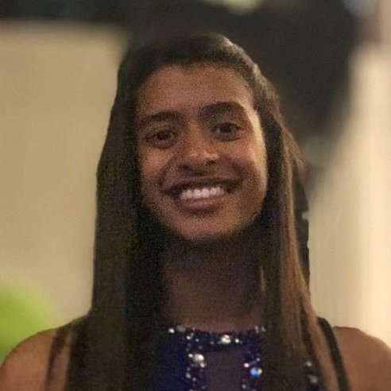
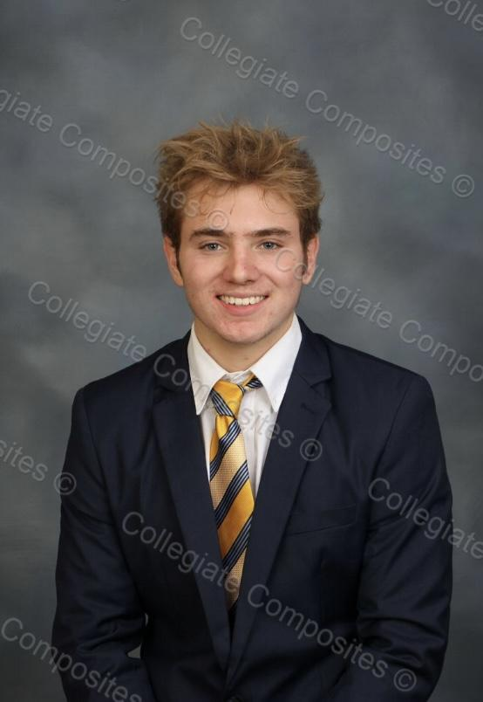
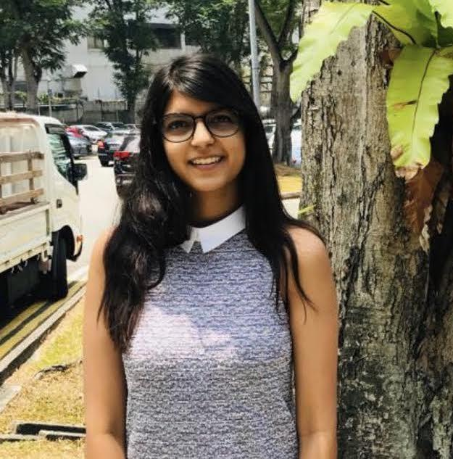
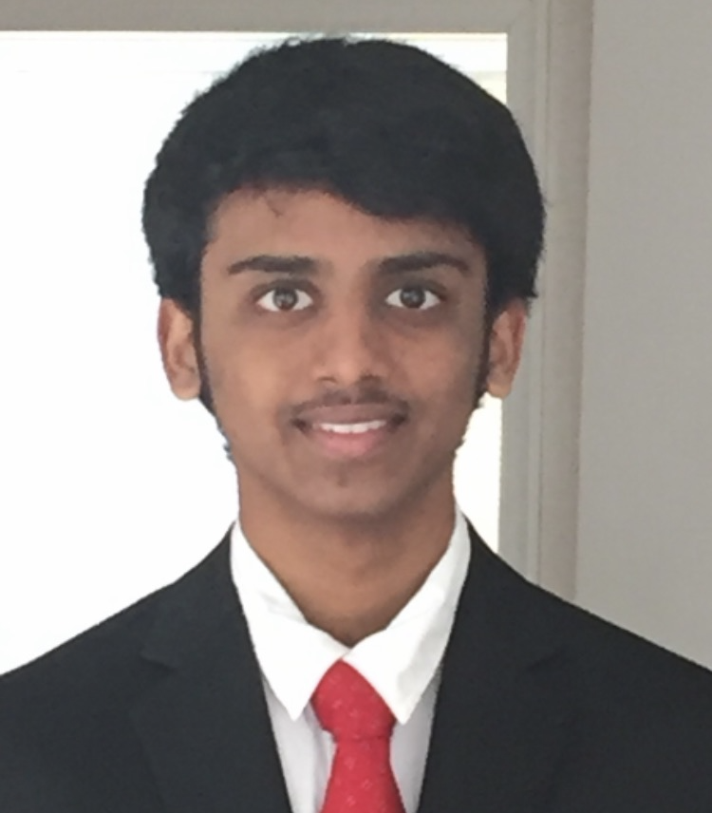
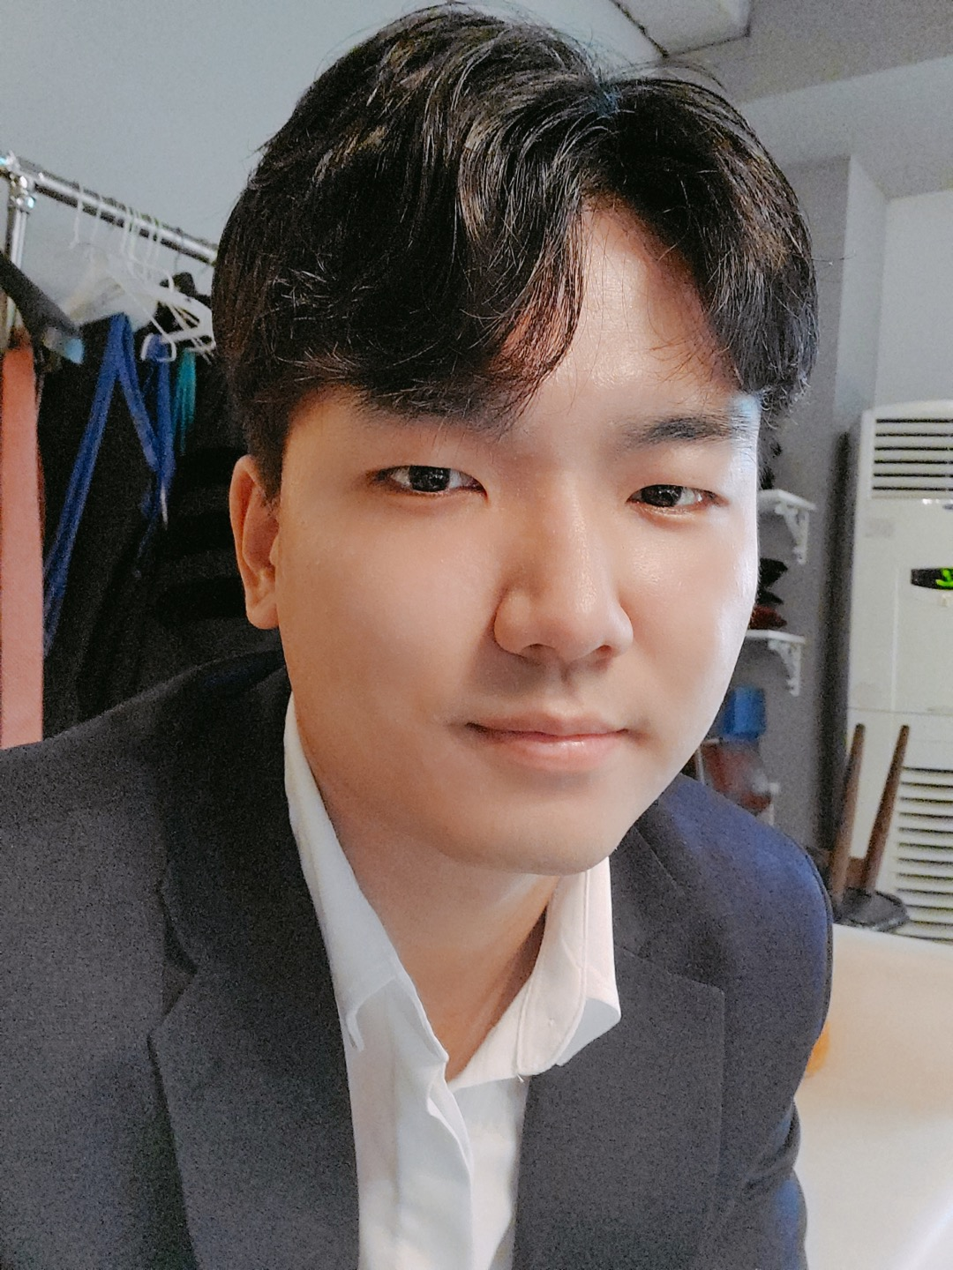

Team Members
Malav Patel
Data Scientist
Hyun Soo Kim
Back-end
Developer
Nidhi Pai
Data Scientist
Daniel Schall
Education Researcher
Aanya Khandelwal
Back-end
Developer
Gautam Sugasi
Back-end
Developer
Jisan Park
Data Scientist
Pratik Agarwal
Project Manager
Notes:
All

Slide 3


Introduction
Discussion forums
  Online formats - primary source of interaction
Student interaction
  Cognitive presence
  Social presence
Activity on forums indicative of student engagement and interest
Goal: Creating a web application to help instructors save time on managing forums and increase cognitive engagement in their courses
Notes:
Pratik
Just as a refresher, we’re working with Discussion forums data on Piazza from Dr. Thad Starner’s CS 6601 course. Discussion forums are particularly interesting since they’re the primary platform for student interaction in an online setting, and our goal in that context is to create a web-app that can be used by instructors to make their courses more effective and engaging, and reduce operational overheads.

Slide 4
Current Progress
Category | Accomplished | Next Goals
Web Dev | Connected with the Piazza api using python script | Create api to send responses to front-end and perform integration testing
UX Research | Basic wireframe ready to get feedback on from instructors | Feedback + create high-fidelity design for dashboard
Data Science | Created first version of topic model | Integrate with the backend and improve topic model
Education Research | Preliminary background study on metacognition | Perform initial experiments with our forums data
Learnings and Challenges as a Project Manager:
Team is awesome. Give individuals autonomy and they’ll exceed your expectations
Need to work out how to be truly agile and prepare for bottlenecks
Notes:
Pratik
Coming to our progress so far, the sub-teams have divided the tasks to get the pilot app working in the Piazza Sandbox environment. To give some context, the input to our web-app is the discussion forum posts on Piazza and the output is a dashboard that showcases metrics, charts and other relevant insights from this data. So, the UX team has created a wireframe to get a sense of what’d the user see on the dashboard. Next they’ll be working on getting feedback on this wireframe and create higher fidelity design based on which our front-end interface can be developed. The metrics and insights come from the models created by the data science team which they’ll work on integrating with the web-app next. The models need data which the backend team has managed to get into our database from Piazza using a script connecting with Piazza api. The next steps here would be to integrate the entire pipeline from Piazza to our database to the dashboard and test it. In addition, we’re also exploring a new direction of further study incorporating metacognition into our analysis which Daniel will be talking about in more detail. Coming to my learnings as a project manager over the past 2 semesters. I realized that my team is awesome and that a very integral part of a functioning team is mutual respect, trust and value alignment. Each of them takes ownership of the project and on giving them autonomy they often surpass expectations. All you need is to give them direction and feedback to help them grow. But it’s not perfect. We still need to figure out ways to be truly agile and prepare for bottlenecks before they actually arise which is partly on me, but others can contribute too.

Slide 5

Targets for semester end
Development
  A responsive web-app tested inside the Piazza sandbox environment
Research
  Metacognition prediction and topic model fit for preliminary use by instructors
Project Management
  Documentation/User Guide + Proposal for testing in a real class
Notes:
Pratik
Coming to targets for sem end, we want to come up with a responsive web-app tested inside the Piazza sandbox environment. On research side, we’ll focus on getting our topic model working to a satisfactory level to perform clustering on posts as well as get a preliminary model of metacognition on our data. In addition we’d work on creating a user guide and proposal for testing with instructors in a real class.

Slide 6
Data Science

Slide 7
Research Goal
Based on the community of inquiry framework, what are some key factors in discussion forum activities influencing student engagement and performance in an asynchronous online classroom?
How can we design a web app that can provide actionable insights to the instructor in order to increase engagement and performance?
Notes:
Our research goal for this semester has been to work on cognitive and metacognition presence to provide actionable insights such visualized graphics data to the professors through a web application. We are trying to analyze students’ engagement and performance in an asynchronous online classroom and search for ways to how metacognition plays an important role in such an environment.

Slide 8
Data Science Big Picture
Data available
  Focusing on Piazza data from Dr. Thad Starner
  1493 posts, coded for cognitive presence and working on Topic Modeling
Cognitive Presence
Sentiment Analysis
Data Science
Topic Modeling
Metacognition
Notes:
We started with performing Sentiment Analysis on the Piazza data that we got last semester from Dr. Thad’s course. But after getting feedbacks from the TAs we realized that sentiment score would not be the right metric to present to the professors. Therefore, we starting working on Topic Modeling as a new branch to help professors get an insight on the topics in piazza discussions. Another branch that our team is exploring is metacognition and how it’s important to the professors. Now Jisan will be diving deep into the details of Topic Modeling.

Slide 9
Why this is useful?
The results of this modeling will be used by the web-dev team to display a group of words and their probability distribution of the key topics of discussion in Piazza forum.
Based on the TA feedback, this modeling will also help TAs/prof. answer similar questions (based on topic distribution) from previous semesters to ease their work.
Three models we used to perform topic modeling:
  LDA (Latent Dirichlet allocation)
  BERT + LDA
  Roberta
Notes:
Jisan

Slide 10
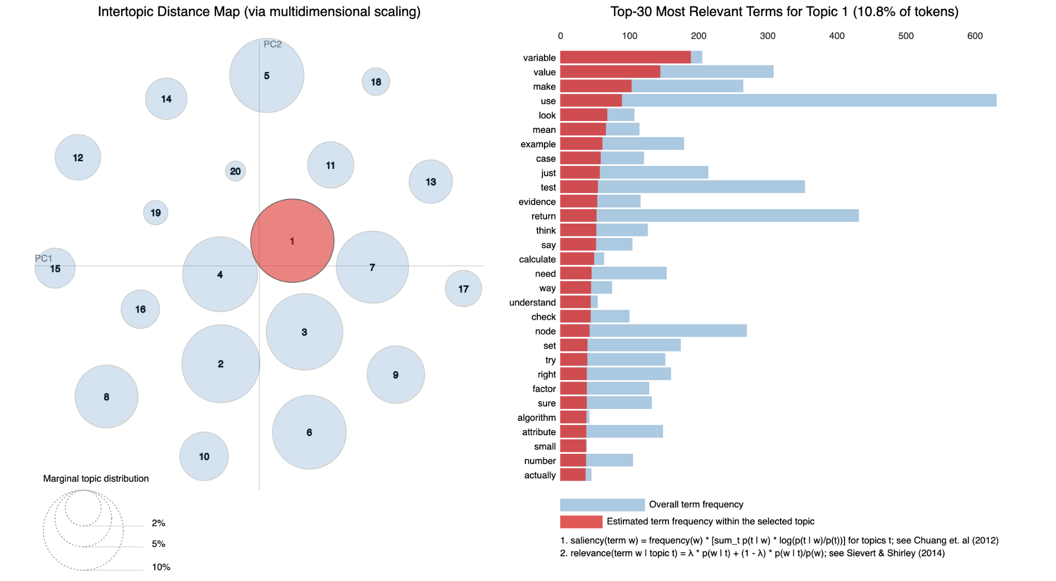
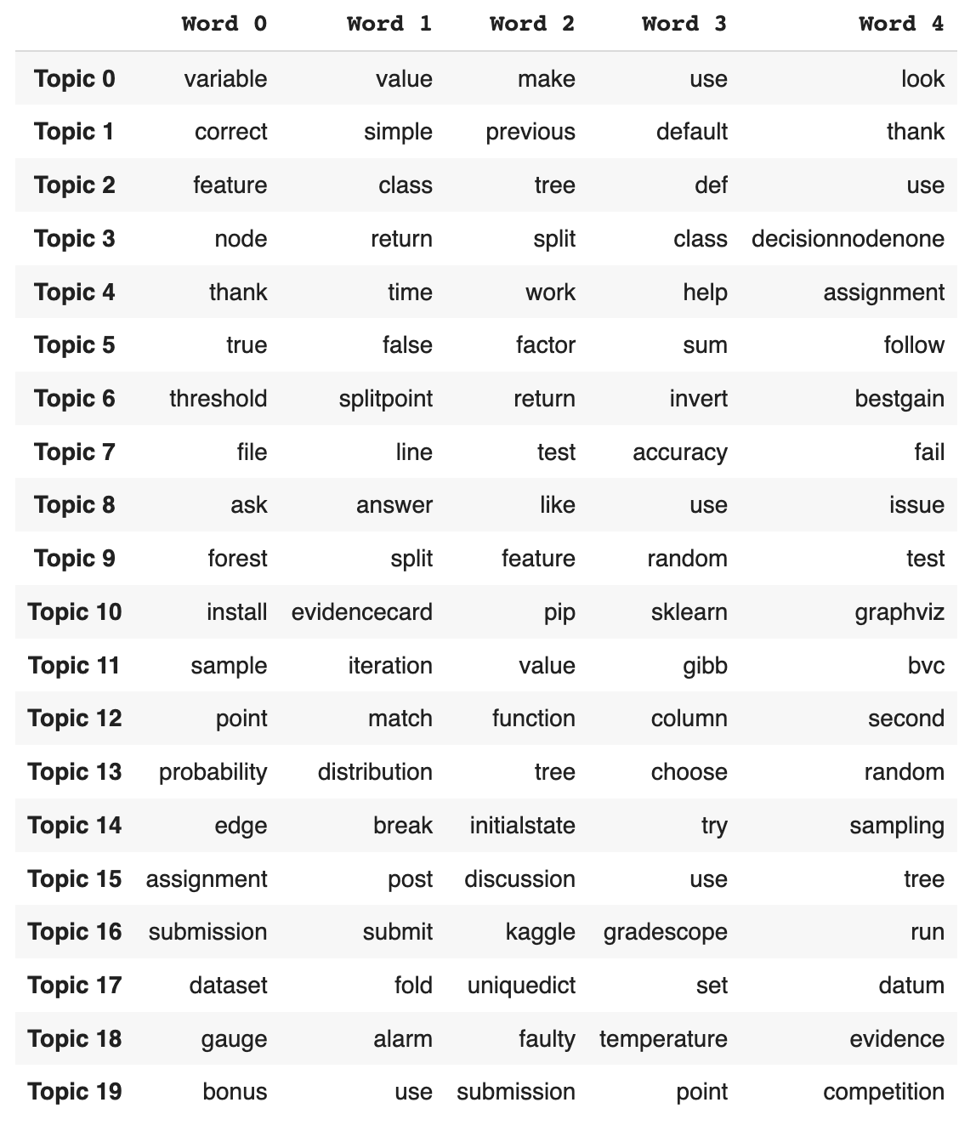
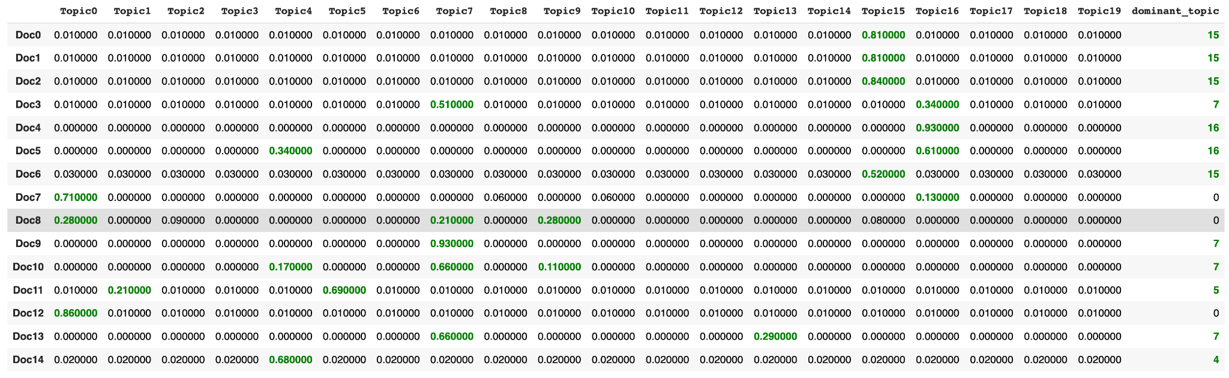
Topic Modeling using LDA
Latent Dirichlet Allocation
  Topic Distribution in docs
  Weight of words in topics
Notes:
Jisan

Slide 11
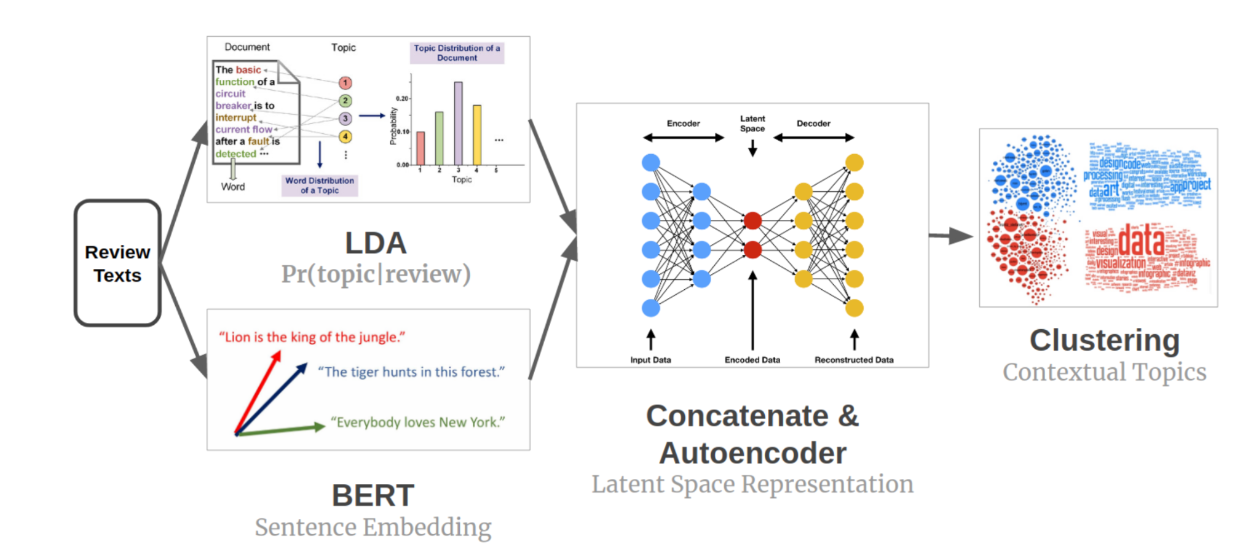
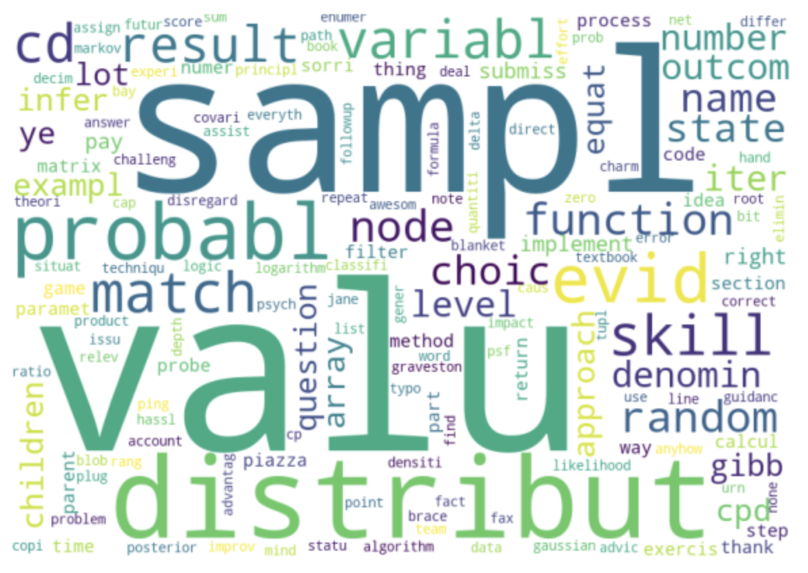
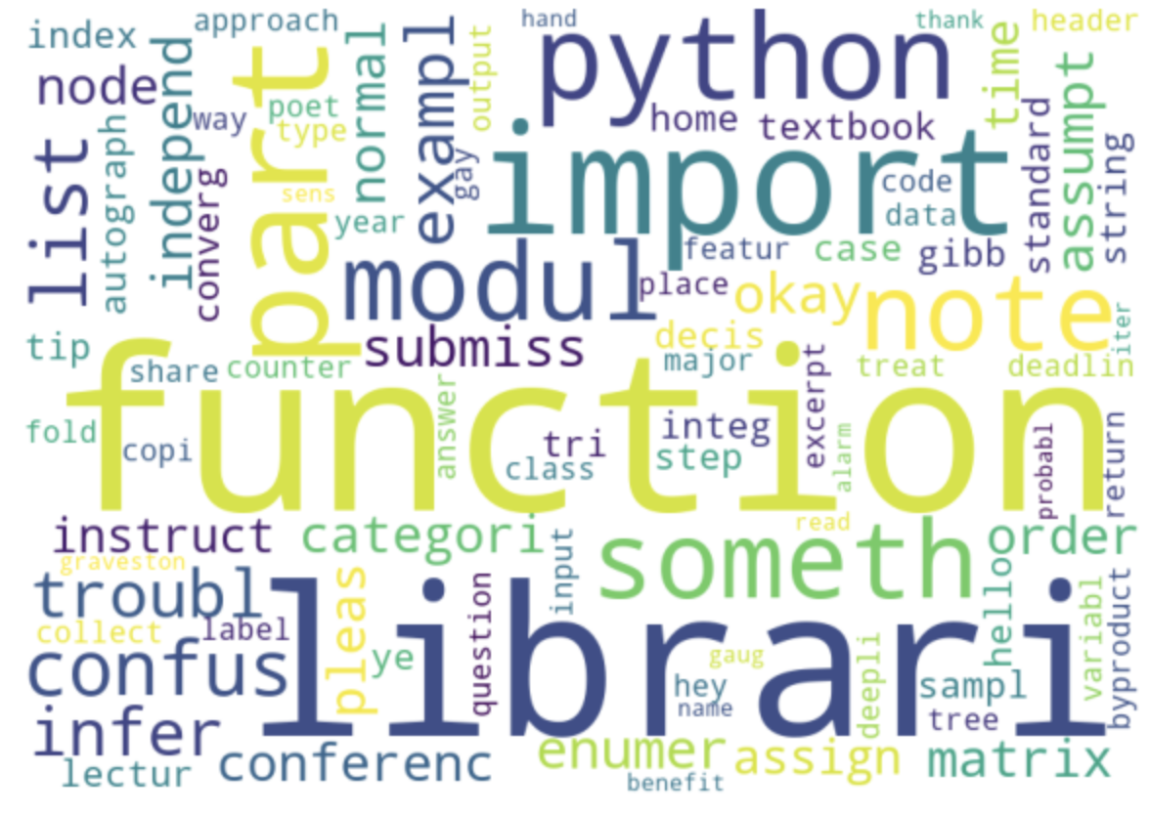
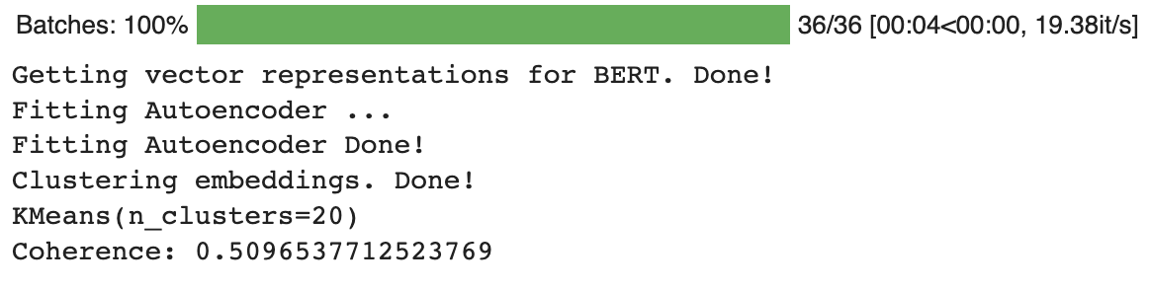
Topic Modeling with BERT+LDA
Bert for sentence embedding vector
LDA for probabilistic topic assignment vector
Coherence Score = 0.51 (measure how the topics are interpreted to humans)
Better serves our purpose
Notes:
Jisan

Slide 12
Next Steps
Questions and answers are not separated in the Piazza data we received.
  sentence-classification modeling using CNN (Convolutional Neural Network)
  pre-trained model
  This model classifies a sentence in one of the common sentence types: Question, Statement, Command, Exclamation
Running the model on incoming comments from Piazza API to distribute them into topics using the BERT+LDA Modeling
  our main priority for the other half
Work with the Web-dev team to create a successful pipeline for the final web application.
Notes:
The next steps we’ll be working on throughout the end of the semester are as follows: The data we got from the PRQR team is not formatted correctly and how we needed it to be. For topic modeling that we were supposed to perform, we need to separate questions from the answers from the data. We have a pre-trained neural net that would solve our purpose. The second goal for the project is to create a functional pipeline that could generate probability distribution for the live comments using our trained model. This would be integrated with the web-dev team by fetching data from their SQL database to release our web application at the end of the semester.

Slide 13
Metacognition
Upon researching further into metacognition, we have found that metacognition is especially important in the online classroom because it greatly boosts students ability to set goals, apply learning strategies, and assess their own progress / readiness to take a test on the subject. Essentially, instilling metacognitive thinking partially negates the downside of not having a physical professor guiding instruction.
We also found an open source Metacognitive Presence detection algorithm developed by another study, possibly to be integrated into current text evaluation process. (7) This algorithm has identified keywords and phrases that indicate whether or not the students are using metacognition, and whether said metacognition indicates confidence or unconfidence.
Notes:
Daniel

Slide 14
Web Development

Slide 15


Back-End Web Development
Meeting with PARQR Team
  Considered use of Ed over Piazza
  Unofficial Piazza API for data extraction
  Requested for Python scripts
Meeting with Dr. Lee
  Resolved issues regarding data access
  Permissions for using unofficial Piazza API
Writing Python scripts for data access
  Successfully making API calls to Piazza and retrieving information
  Clarified what fields need to be extracted
  Next steps: Store the information in a database
Meeting with Data Science Team
  Further discussion on table columns/fields
  More on data extraction based on megathread vs. individual post content
Notes:
Aanya

Slide 16
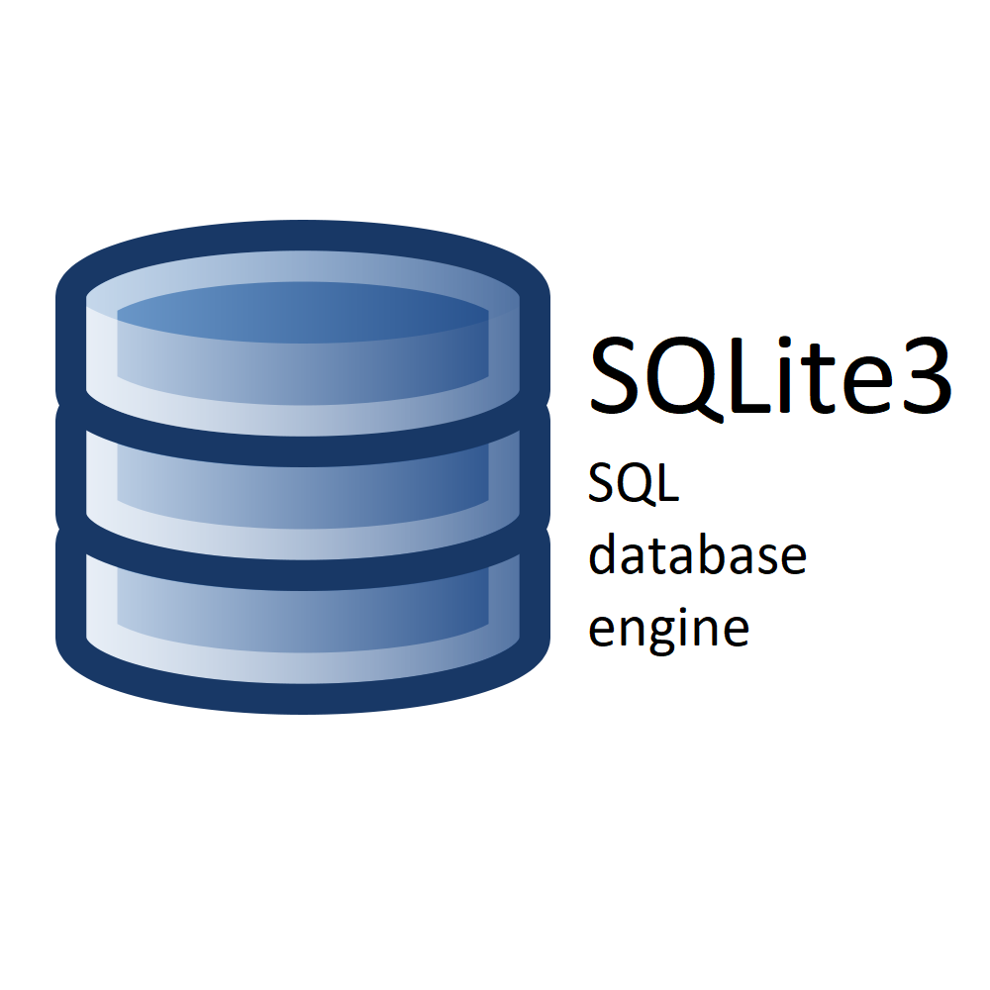

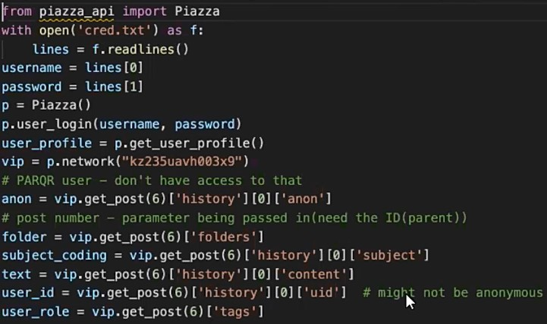

Workflow Diagram
Analysis from Data Science team
Integrate into database and a real time prototype
Last presentation
Extract real time Piazza data
Use our pilot app to support professors
Here right now
Future goal
Notes:
Harriet

Slide 17
Front-End Web Development
Worked closely with the UX Team on developing prototypes for how the dashboard should look like
Notes:
Gautam

Slide 18
UX Research

Slide 19
User Surveys & Interviews
Research Question: What metrics on a dashboard are useful to instructors in order to improve student engagement & performance and/or reduce workload for instructors?
Goals:
Collect ideas & insights from users on utility of metrics.
Find the intersection between valuable metrics and feasible metrics.
Pilot test prototypes with users.
Notes:
Gautam

Slide 20
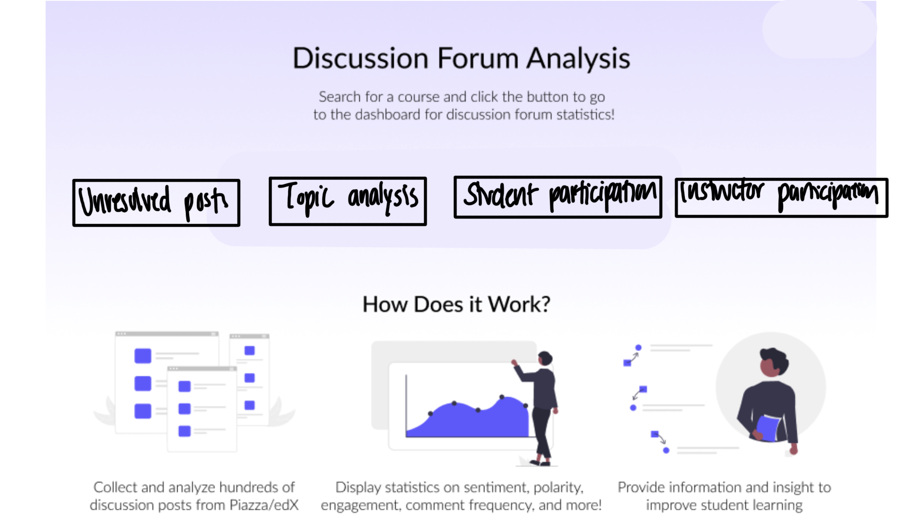
Notes:
Gautam
mention that’s canvas integrated

Slide 21
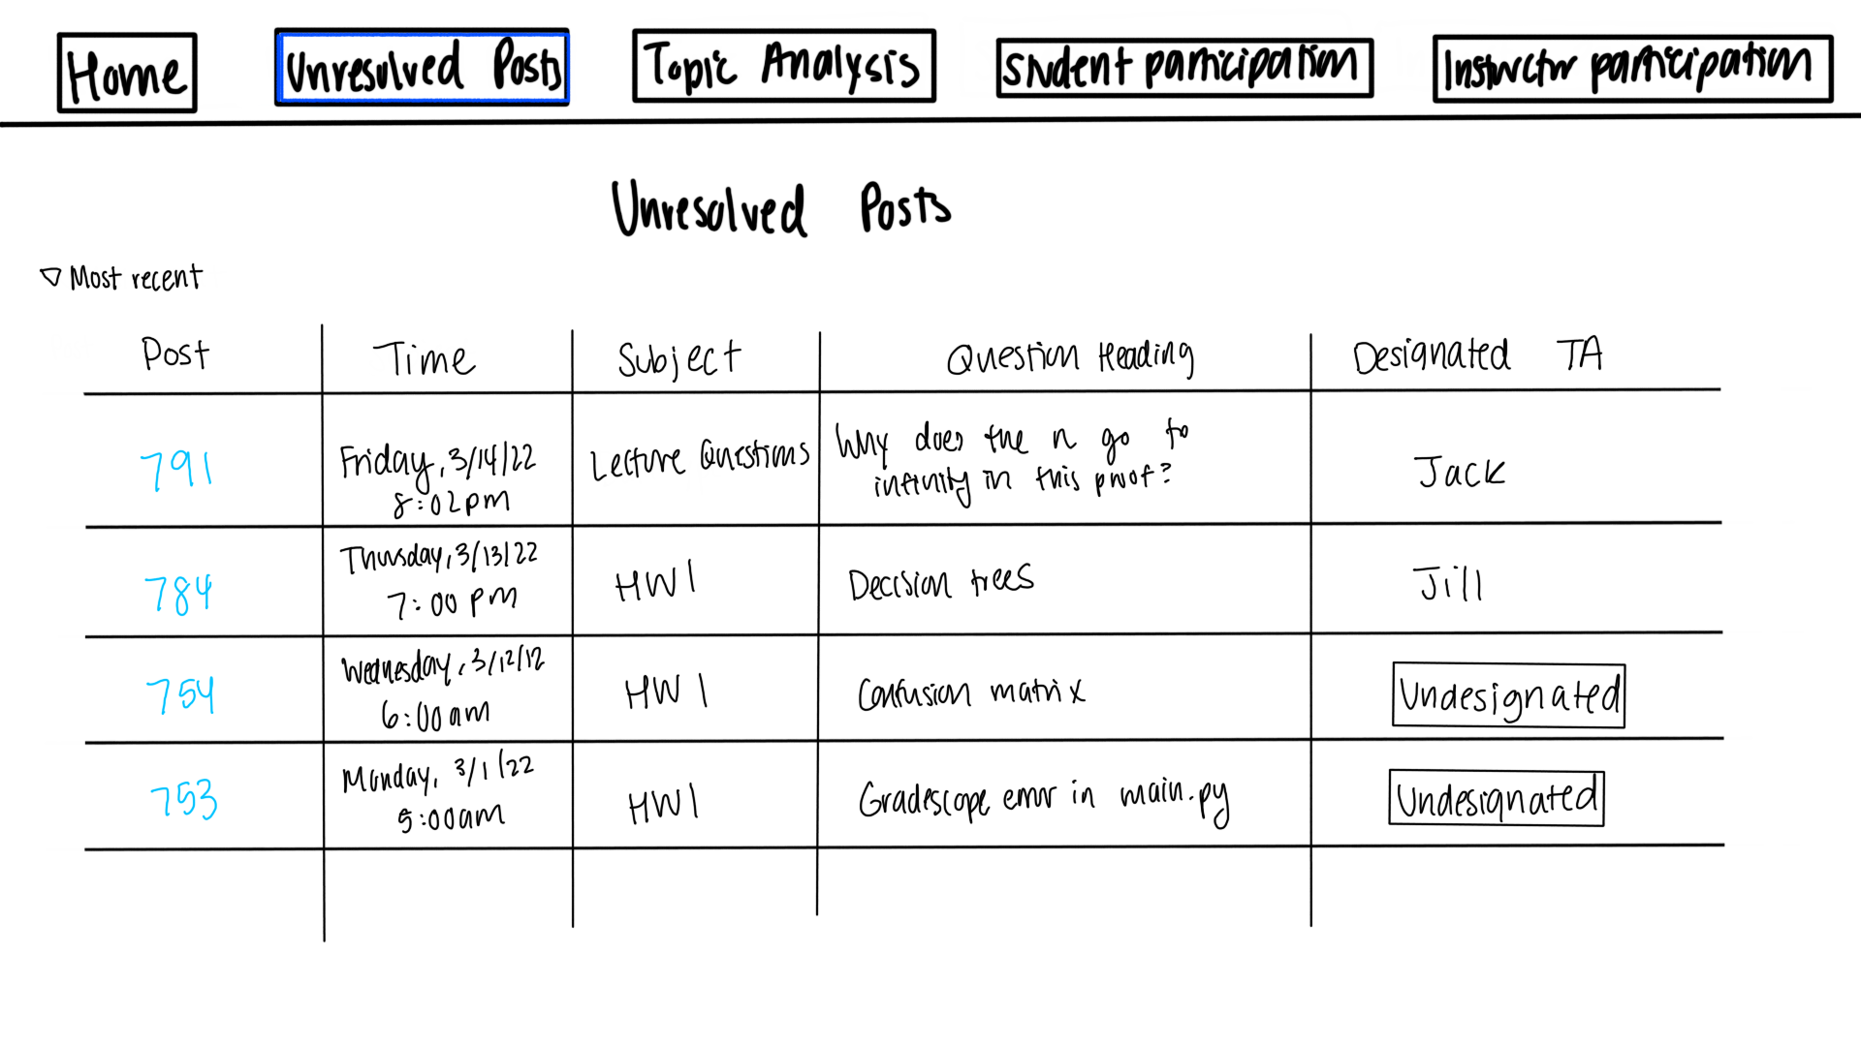
Notes:
Gautam
unresolved posts to allow TAs to quickly see what needs their attention
Head TA can designate people for each post so that work can be distributed evenly

Slide 22
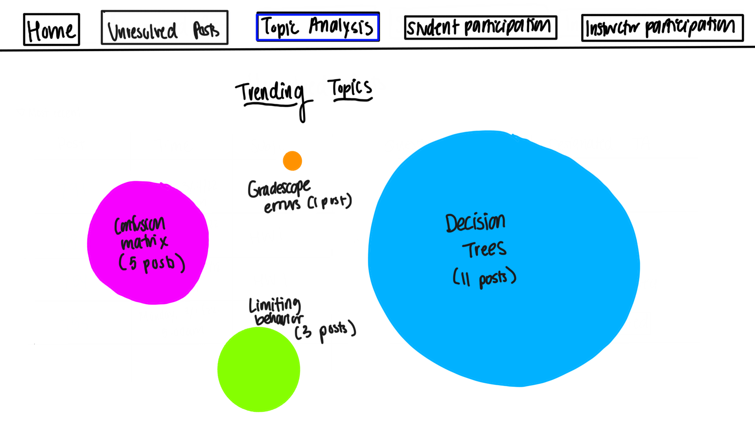
Notes:
Nidhi
result of data science topic analysis
see the topics with the most questions so that they can choose what to go over

Slide 23
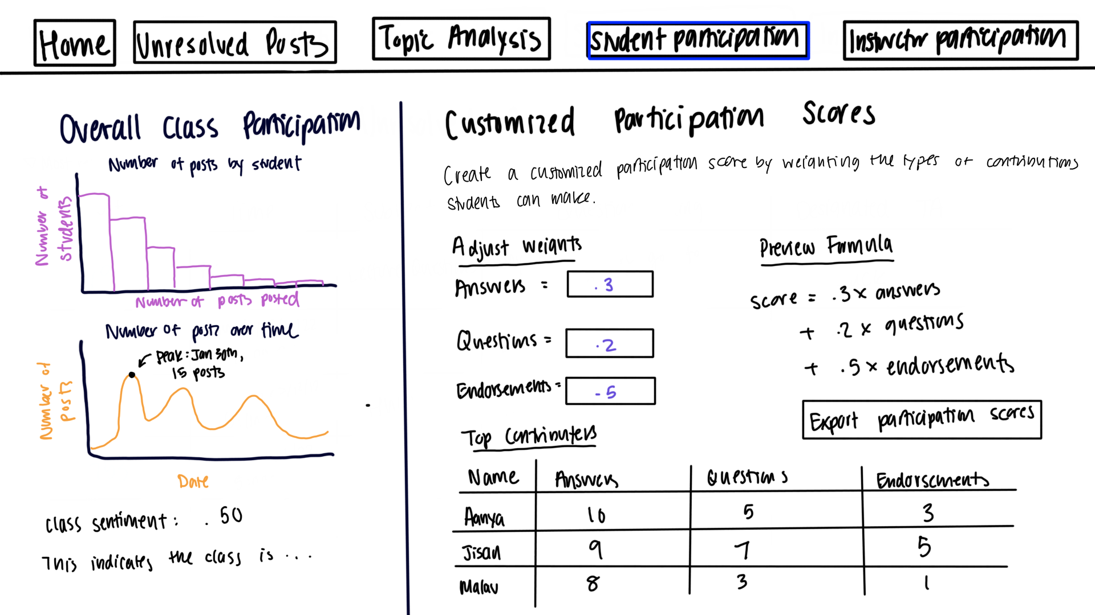
Notes:
Nidhi
overall student participation

Slide 24
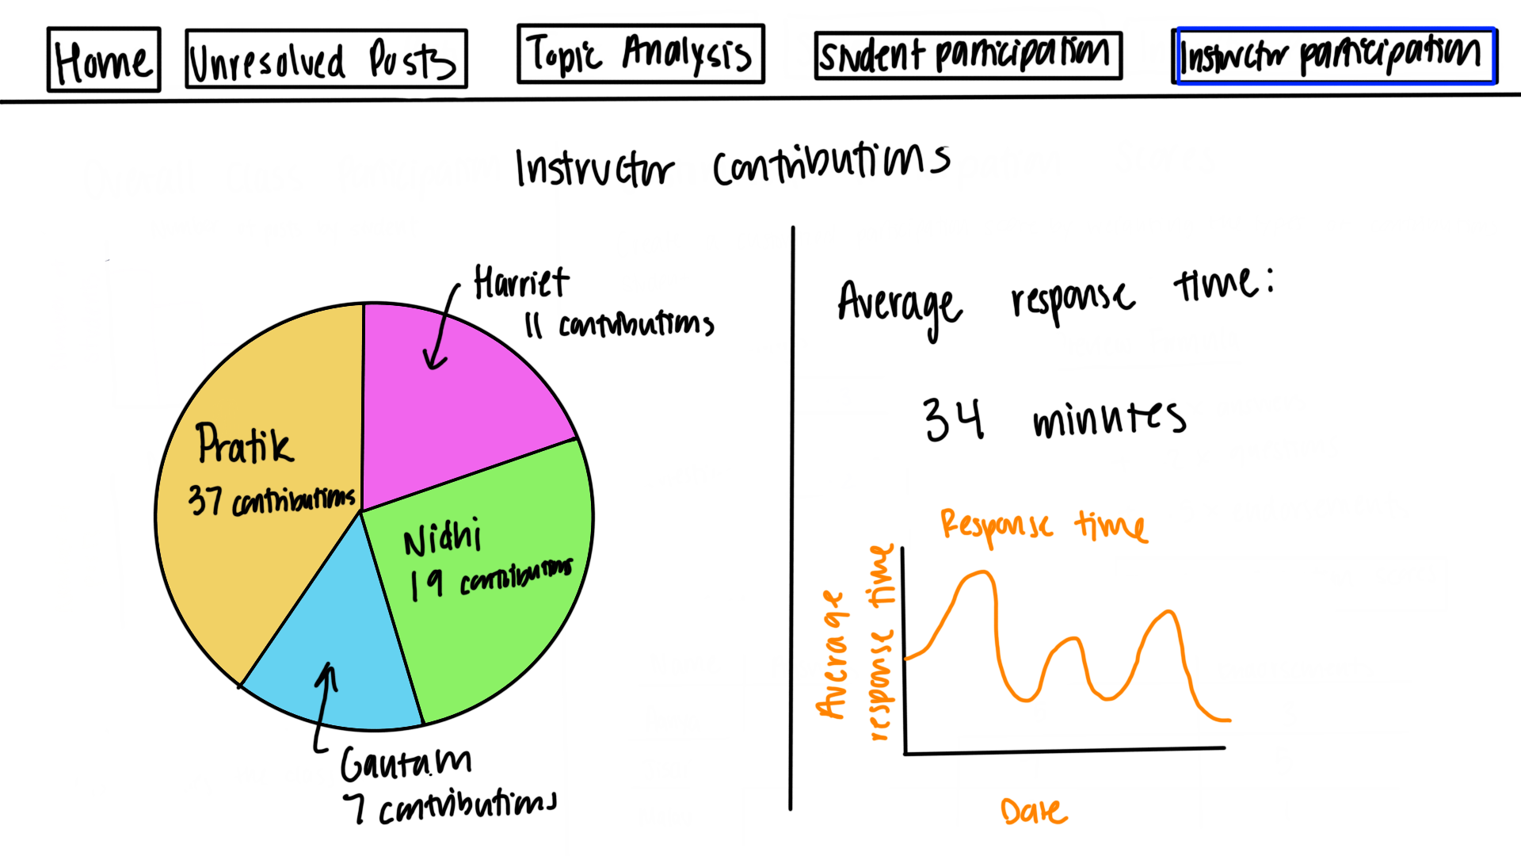
Notes:
Nidhi
instructor contributions

Slide 25
Conclusions & Semester Roadmap for UX
Next steps:
Collect some feedback from users on current mockups
Refine handwritten mockup content
Think about visual design - themes, colors, etc
Create designs on Figma
Notes:
Nidhi

Slide 26
Conclusion
Project Roadmap
  Get the web-app deployed after testing it in the Piazza environment and connect with instructors to assess feasibility of pilot testing in a real class
Model Development
  Test and iterate on the topic models to generate related question clusters
Education Research
  Explore effectiveness and potential of metacognitive classification model on Piazza and EdX data
Notes:
Pratik
To conclude, the next steps in the roadmap is getting the web-app deployed, use topic modeling approach to cluster similar posts which will help create an FAQ list in advance and help reduce overhead by reducing volume of repetitive questions, and get quick feedback from instructors. In education research, our focus will be on understanding metacognition and its manifestation in online discussion forums. Thank you for your time.

Slide 27
Citations
Garrison, D. R., Anderson, T., & Archer, W. (1999). Critical Inquiry in a Text-Based Environment: Computer Conferencing in Higher Education. The Internet and Higher Education, 2(2–3), 87–105. https://doi.org/10.1016/S1096-7516(00)00016-6
Garrison, D. R., Anderson, T., & Archer, W. (2001). Critical thinking, cognitive presence, and computer conferencing in distance education. American Journal of Distance Education, 15(1), 7–23. https://doi.org/10.1080/08923640109527071
Devlin, J., Chang, M. W., Lee, K., & Toutanova, K. (2018). Bert: Pre-training of deep bidirectional transformers for language understanding. arXiv preprint arXiv:1810.04805.
Medhat, Walaa, Hassan, Ahmed, Hoda, Korashy (2014). Sentiment analysis algorithms and applications: A survey. Ain Sham Engineering Journals. https://doi.org/10.1016/j.asej.2014.04.011
MacMillan, Kelsey, and James D. Wilson. Topic Supervised Non-Negative Matrix Factorization, Arxiv, 4 July 2017, https://arxiv.org/pdf/1706.05084.pdf.
Beri, Aditya. “Latent Dirichlet Allocation.” Latent Dirichlet Allocation, CodeChef-VIT, 27 Jan. 2021, https://medium.com/codechef-vit/latent-dirichlet-allocation-812bb8099518.
E. Huang, H. Valdiviejas and N. Bosch, "I'm Sure! Automatic Detection of Metacognition in Online Course Discussion Forums," 2019 8th International Conference on Affective Computing and Intelligent Interaction (ACII), 2019, pp. 1-7, doi: 10.1109/ACII.2019.8925506.

Slide 28
Questions?

Slide 29
Data Science Goals
First, focus on
Timeframe
Notes:
Malav

Slide 30
Approach used in previous semester
The classic WMD example from [5]

Slide 31
Challenges encountered

Slide 32
Goals for this semester (Data Science)
Sentiment Analysis of Piazza Data

Slide 33

Community of Inquiry
“a group of individuals who collaboratively engage in purposeful critical discourse and reflection to construct personal meaning and confirm mutual understanding”
Elements of an Educational Experience (Garrison et al., 1999)

